Slide 1
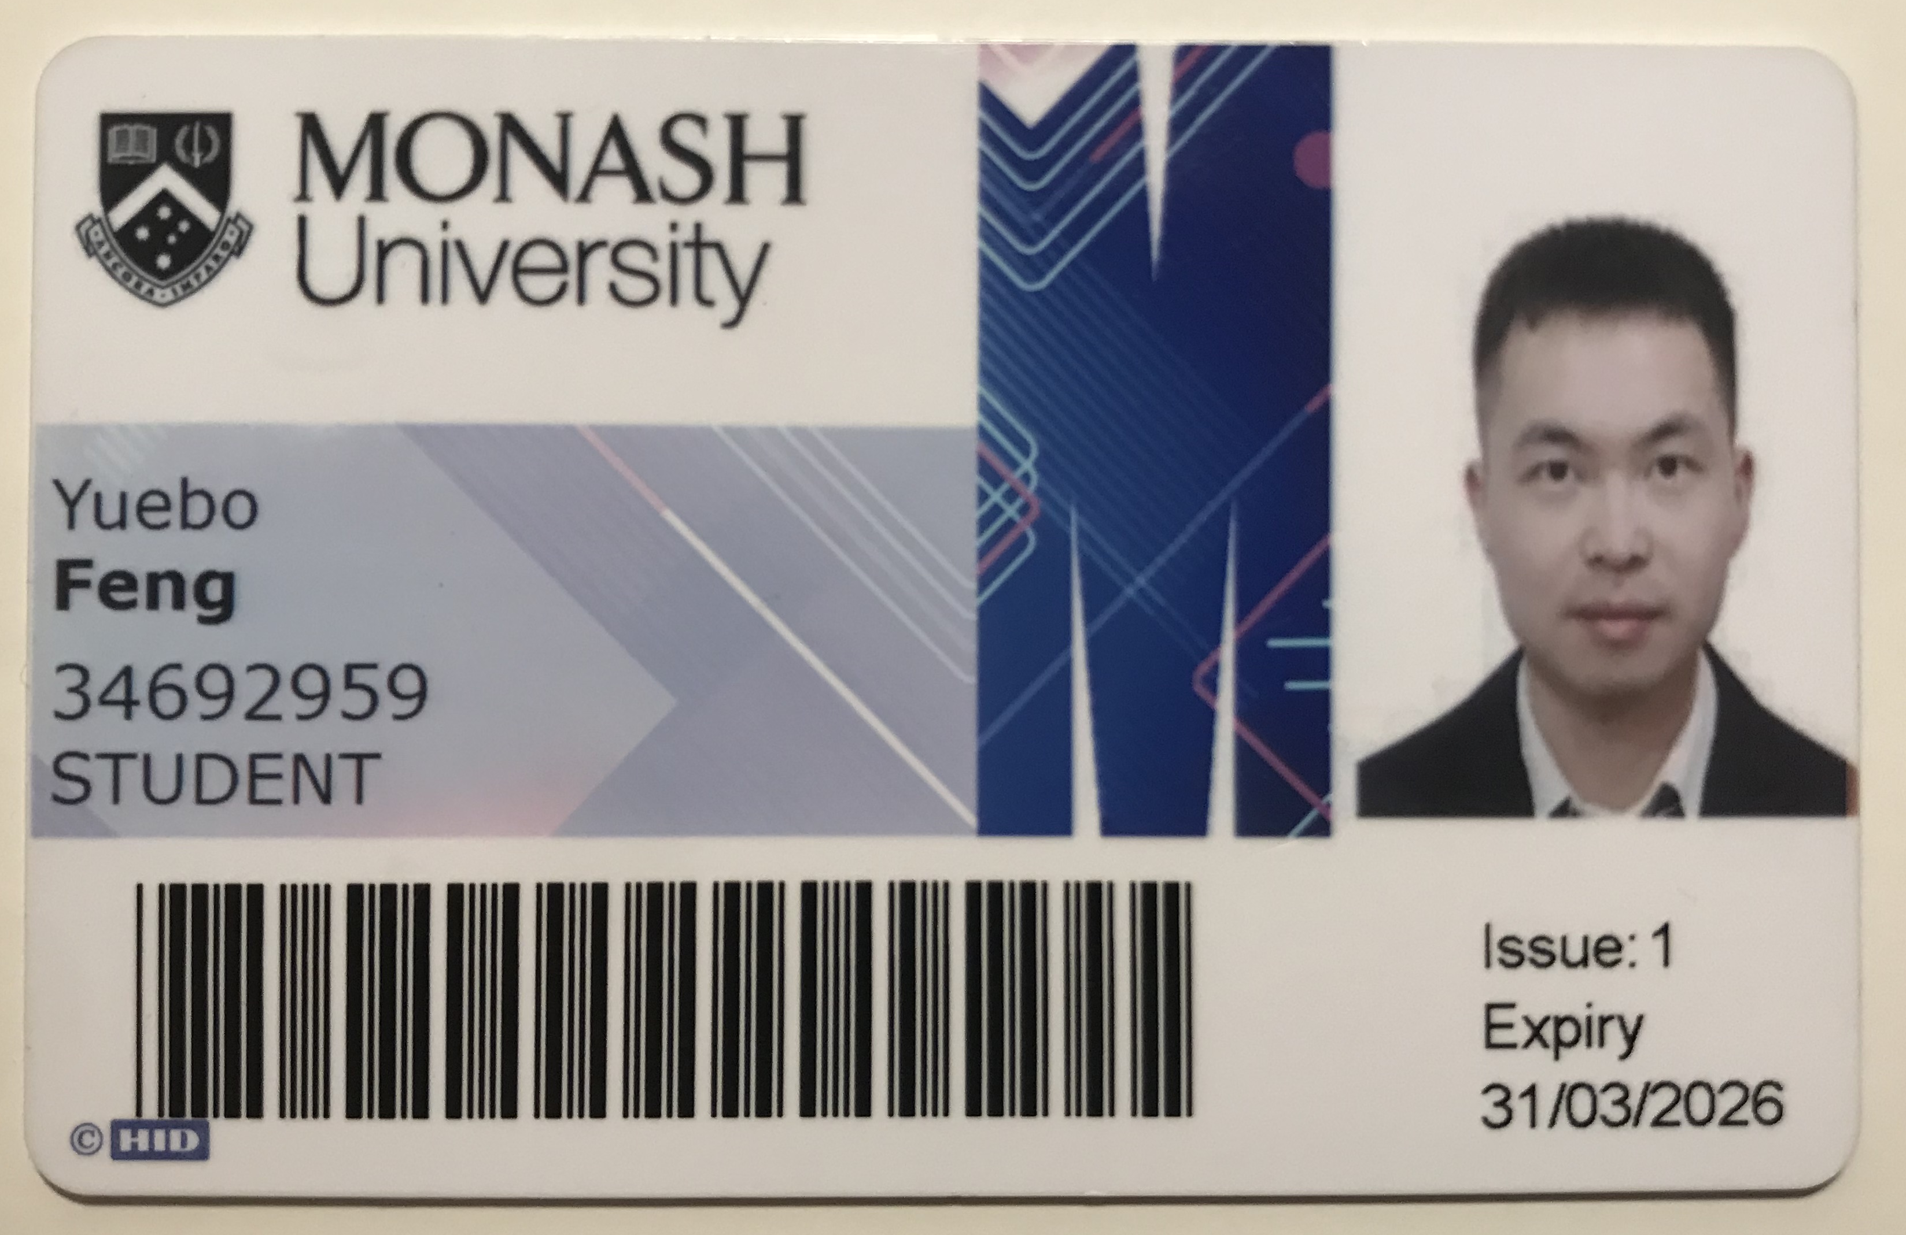
FIT9137 – Assignment 2 2024 Semester 1
Yuebo Feng 34692959

Slide 2
Content
Problem Definition
Network Design
Conclusion and Recommendation
Reference
Appendix

Slide 3
Problem Definition: Assumptions
Structure and size of floors in each building are exactly same.
New Employees are equally assigned to each floor of each building.
(600 - 360) / 2 / 2 = 60;
Peak time users are evenly distributed onto each floor of each building.
Because of substantial increasement, suppose all 60 users each floor peak time.
Take the top level of average traffic per user(30Mbps) into consideration.
Main Office Network is capable enough to cover all new network needs in all buildings.

Slide 4
Problem Definition: Requirements
Within Each Floor:
Total wired network requirement: 30 * 60 = 1800 Mbps;
Total wireless network requirement: 30 * 25% * 60 = 450 Mbps;
substantially increase
Within Each Building:
A wiring closet with 4 fiber optic cables
Around the Buildings:
Connection to the existing Main office network

Slide 5
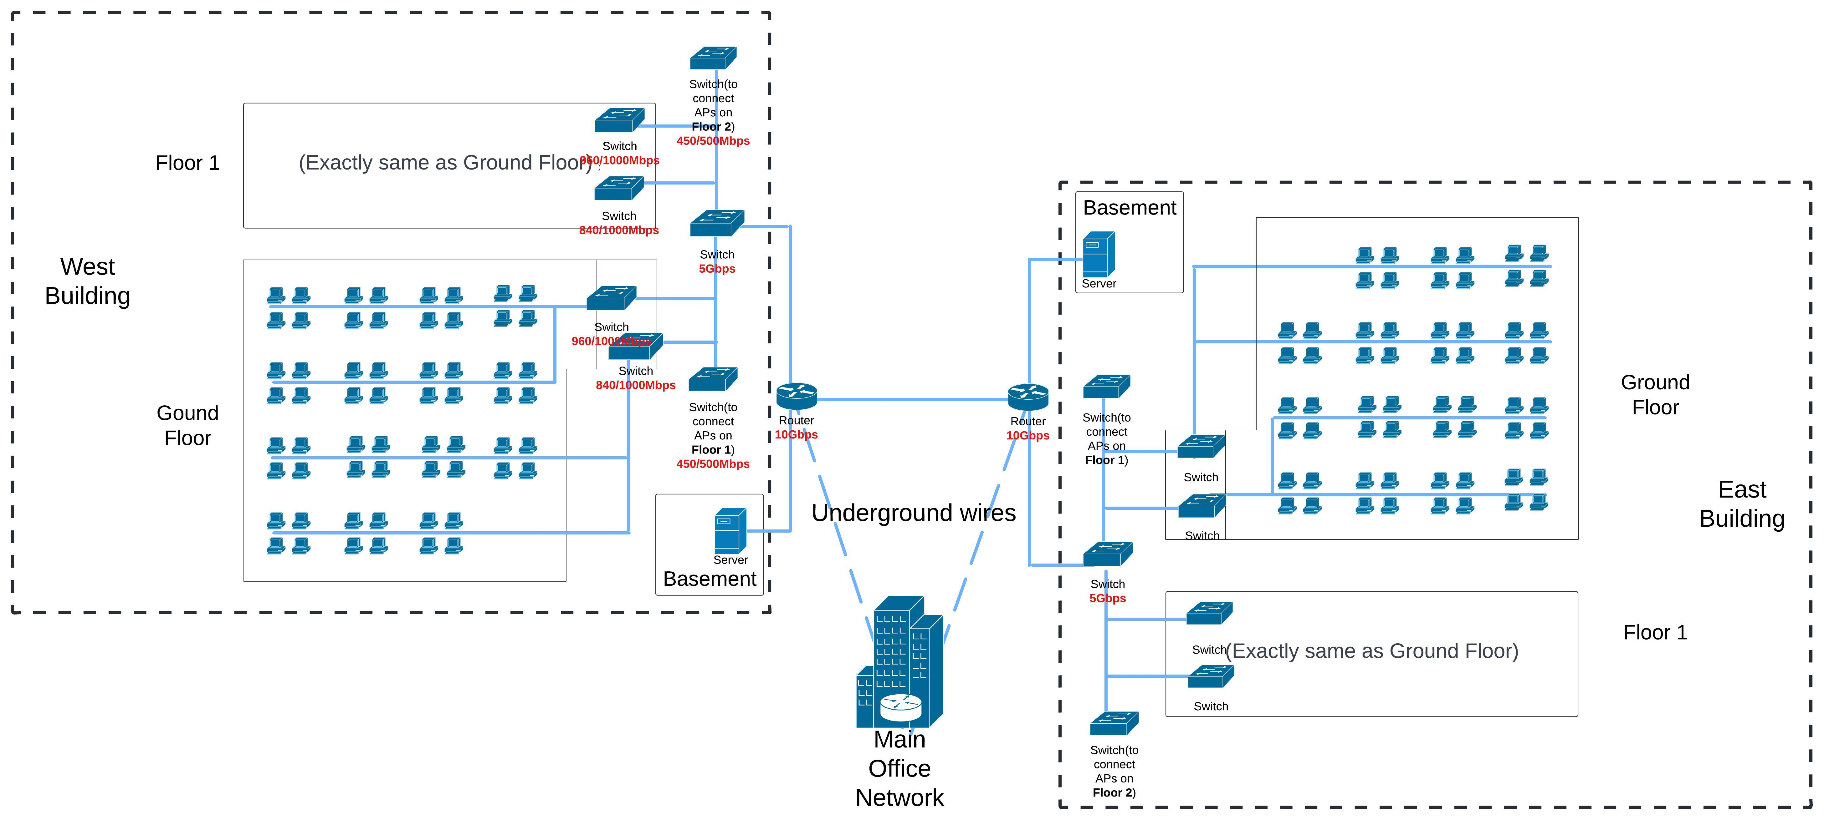
Network Design: Wired Network

Slide 6
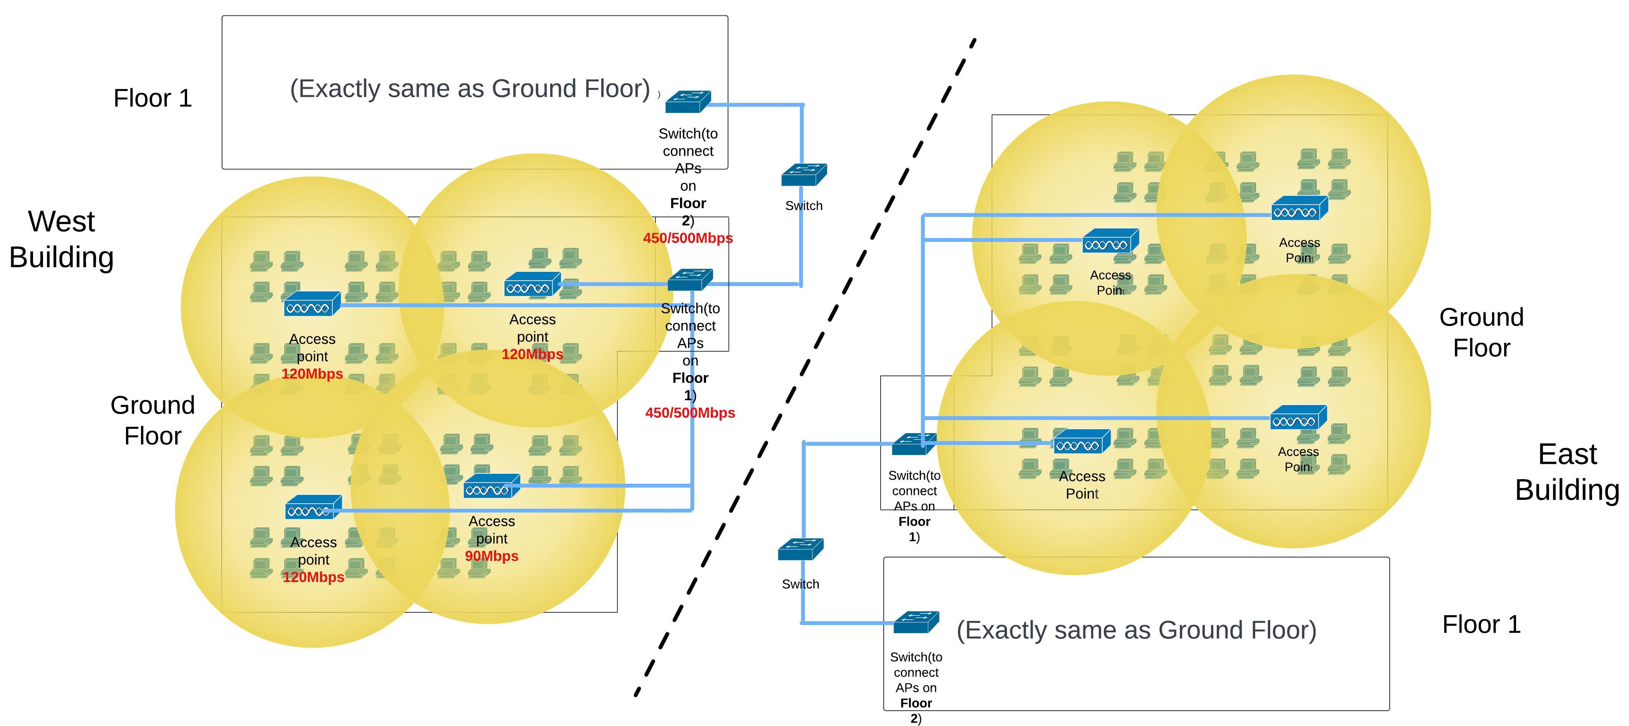
Network Design: Wireless Network
Channel 11
Channel 1
Channel 11
Channel 1
Channel 11
Channel 6
Channel 6
Channel 11

Slide 7
Network Design: Backbone Network

Slide 8
Network Design: Ethical Problem solving
Unexpected behaviours:
Access and modify sensitive data.
Share sensitive data out.
Access network with personal use.
Solutions by server:
A database of sensitive data: set up passwords
Set authority to access data
Strict the network accessibility to only work content.

Slide 9
Network Design: Backbone Network

Slide 10
Network Design: Length
8m
16m
24m
32m
3m
20m
50m
100m
3m

Slide 11
Network Design: Length
16m
32m
3m

Slide 12
Network Design: Brand, Series and Costs
Access point
TP-Link EAP223
Up to 1317 Mbps
Price: AUD 150 * 4 * 2 * 2 = AUD 2400
1000-Mbps switch: connecting PCs and Aps
TL-SG116
16 ports for 10/100/1000Mbps
Price: AUD 120 * 3 * 2 * 2 = AUD 1440
5-Gbps switch: main switch in each new building
TL-SG116P
Up to 250 m data and power transmission range
Price: AUD 200 * 2 = AUD 400

Slide 13
Network Design: Brand, Series and Costs
10-Gbps router: main router in each new building
Archer AX10000
Over 10Gbps
Price: AUD 350 * 2 = AUD 700
Wires:
Optical fiber: AUD 10 per meter
(3 * 2 + 50 + 100 * 2) * 10 = 256 * 10 = AUD 2560
CAT6: AUD 6 per meter
[(32 * 4 * 4 + 24 * 4 * 4 + 16 * 4 * 4 + 8 * 4 * 3 + 20 + 32 * 2 + 16 * 2) * 2 * 2 +
3 * 3 * 2] * 6 = 5474 * 6 = AUD 32844
Total cost
AUD 40344

Slide 14
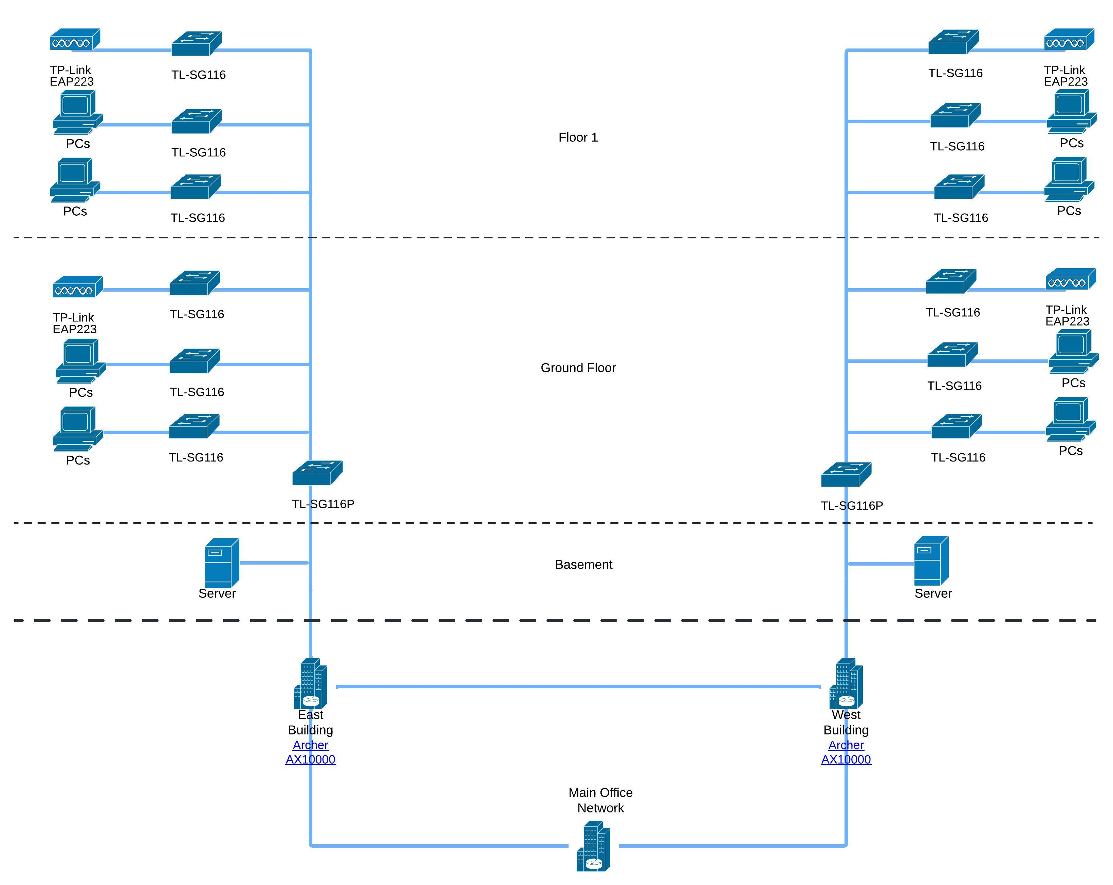
Conclusion and Recommendation
West Building
East Building
Main Building
Road
Road

Slide 15
Conclusion and recommendation
Improvements:
More specific design plans: the capability of Main Building Network, exactly seats(PCs) layout in each floor…
More sustainable: handling the increasing amount of employee, and circumstance of failures.
More precise investigations among network devices.

Slide 16
Reference
[1]Patel, H. (2023, October 12). Network Infrastructure Design: A Comprehensive Guide to Planning and Implementation. WPG Consulting. Retrieved from wpgc.io.
[2]Schabell, E. (2022, May 11). 7 reference architecture designs for infrastructure projects. Red Hat. Retrieved from redhat.com.
[3]List of WLAN channels. (2024, April 26). In Wikipedia. Retrieved from https://en.wikipedia.org/wiki/List_of_WLAN_channels
[4]TP-Link. (n.d.). AC1350 Wireless MU-MIMO Gigabit Ceiling Mount Access Point EAP223. Retrieved April 26, 2024, from https://www.tp-link.com/au/business-networking/ceiling-mount-ap/eap223/
[5]TP-Link. (n.d.). TL-SG116 16-Port Gigabit Desktop Switch. Retrieved April 26, 2024, from https://www.tp-link.com/au/business-networking/unmanaged-switch/tl-sg116/
[6]TP-Link. (n.d.). TL-SG116P 16-Port Gigabit Desktop Switch with 16-Port PoE+. Retrieved April 26, 2024, from https://www.tp-link.com/us/business-networking/unmanaged-switch/tl-sg116p/
[7]TP-Link. (n.d.). Archer AX10000 Next-Gen Tri-Band Gaming Router. Retrieved April 26, 2024, from https://www.tp-link.com/us/home-networking/wifi-router/archer-ax10000/

Slide 17
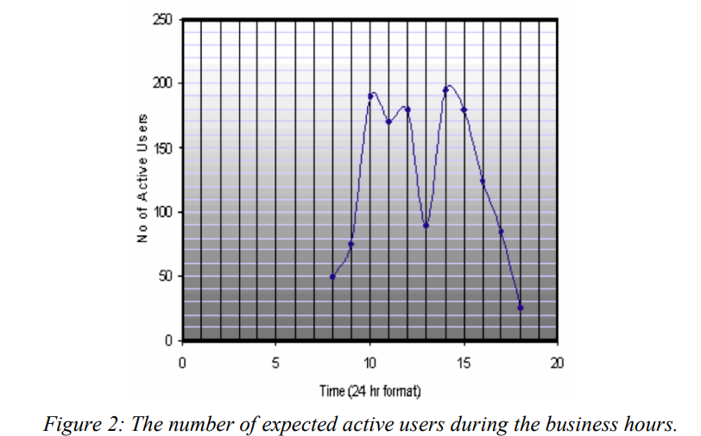
Appendix: Details of Design
Number of employees on each floor of new buildings:
(600 - 360) / 2 / 2 = 60
Take 60 as the number of people on each floor at peak time, instead of:
200 / 2 / 2 = 50
Because 50 and 60 are not much different, and it will
enhance the capability of the network, and benefit
the increasing number of employees in the future.

Slide 18
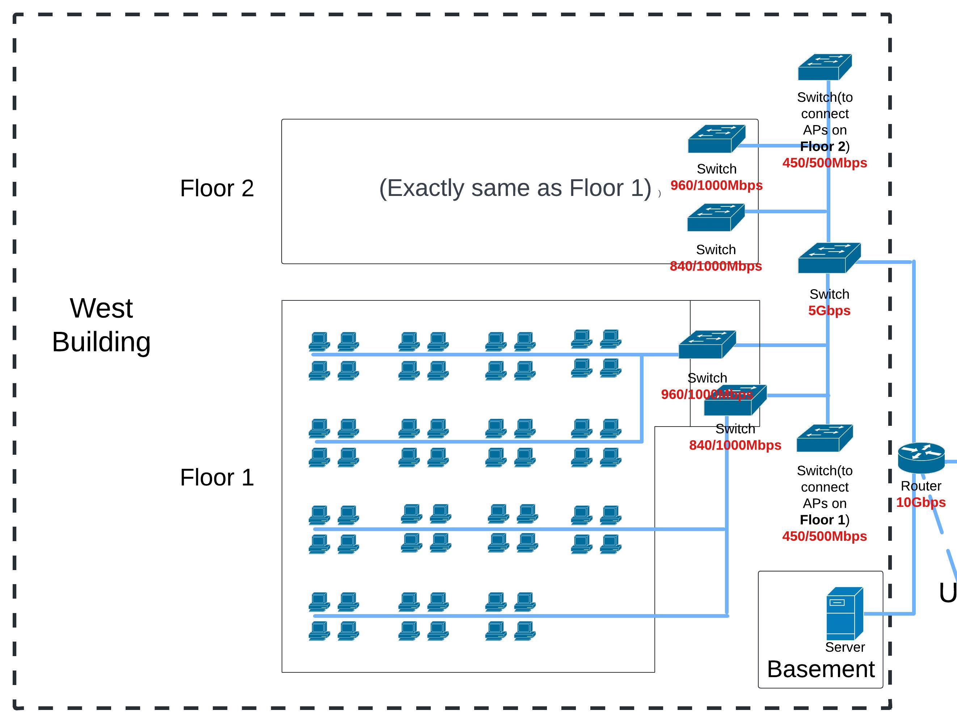
Appendix: Details of Design
Take the Floor 1 of West Building as an example because all the floors in the buildings are the same.
On each floor, 4 people are arranged to a group, and groups are assigned as shown below. Each row of group contains 12 – 16 employees. Plan to connect them in rows, to 2 switches to LAN.
Take the top level of average traffic per user(30Mbps)
into consideration because it will enhance the capability
of the network, and benefit the increasing employees.
Demand calculation:
Wired network of all rows:
30 * 16 * 2 = 960Mbps
30 * 16 + 30 * 12 = 840Mbps
So, the switch should be 1000-Mbps in capacity.
…

Slide 19
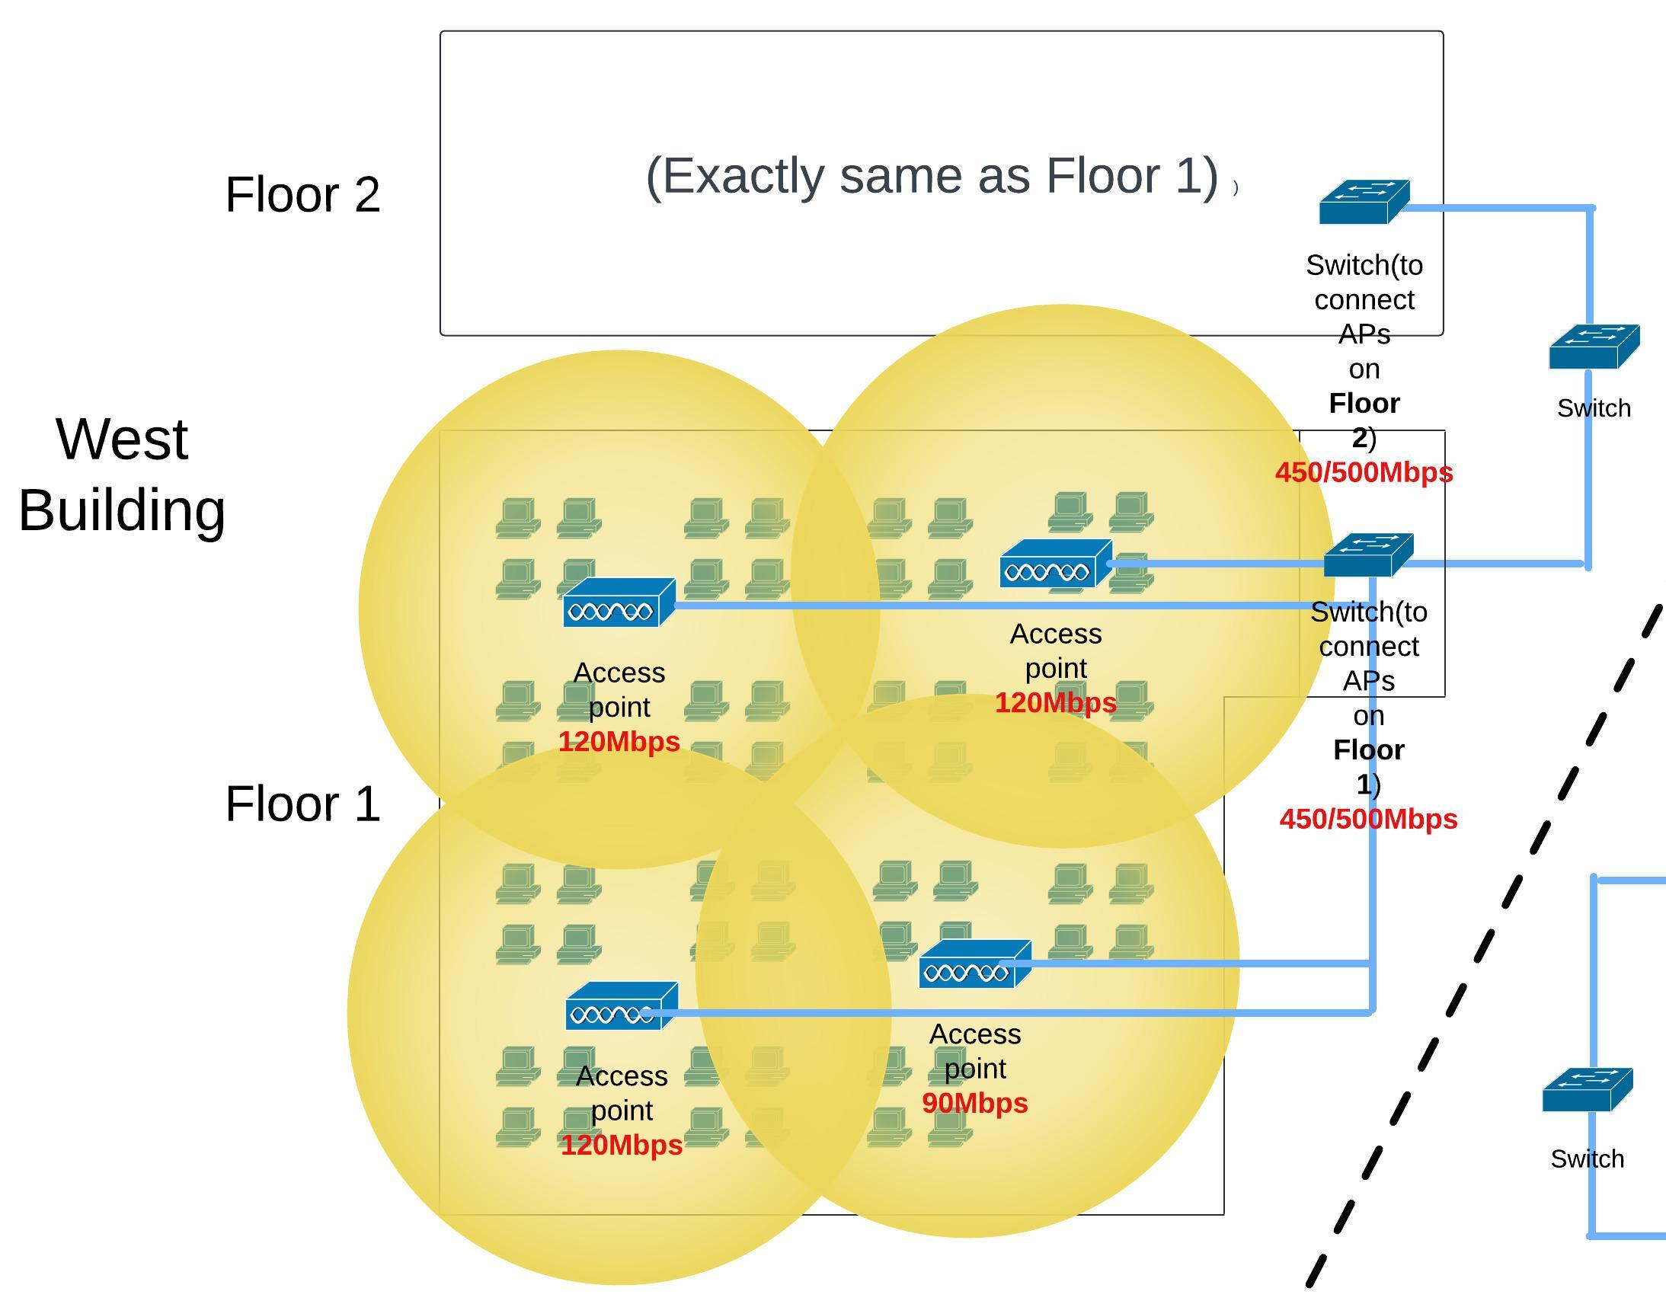
Appendix: Details of Design
Wireless network:
Use 4 20-meter-radius access points(APs) arranged as shown below, making sure every PC and most part of the floor is covered. Each of them are assigned to a larger group with 12 – 16 people.
The 4 APs are then connected to a switch.
Demand calculation:
30 * 25% * 16 = 120Mbps
30 * 25% * 12 = 90Mbps
120 * 3 + 90 = 450Mbps
So, the switch should be 500-Mbps in capacity.
And each AP should be 200-Mbps in capacity.
Channel 11
Channel 1
Channel 11
Channel 6

Slide 20
Appendix: Details of Design
From now on, there are 3 switches are used for each floor:
Wired network: two 1000Mbps switches to connect users’ PCs by wired
Wireless network: a 500Mbps switch to connect 4 Aps
1000 * 2 + 500 = 2500Mbps
2500 * 2 = 5000Mbps
Then, total 6(3 in each floor) switches are connected
to a main switch of the building, and its capacity
should be 5Gbps.
…

Slide 21
Appendix: Details of Design
Then, the 5-Gbps main switch of the building is connected to the main router of the building.
And on the basement, a server is also connected to the router. Inside this server, database of crucial dadas is established, unique passwords to access them are set and restriction among the access content is set to avoid unethical usage.
…

Slide 22
Appendix: Details of Design
24m
For indoor distance,
Each group of 4 PCs will share same- length CAT6 cables.
Based on scale, the measurement results of these different distances are : 32m, 24m, 16m and 8m.
And all cables between floors will be 3m.
For outdoors, it is assumed that the distance between two new building is 50m, and the distance between the two building and the main building is the same: 100m.
8m
16m
32m
3m
20m
50m
100m
3m

Slide 23
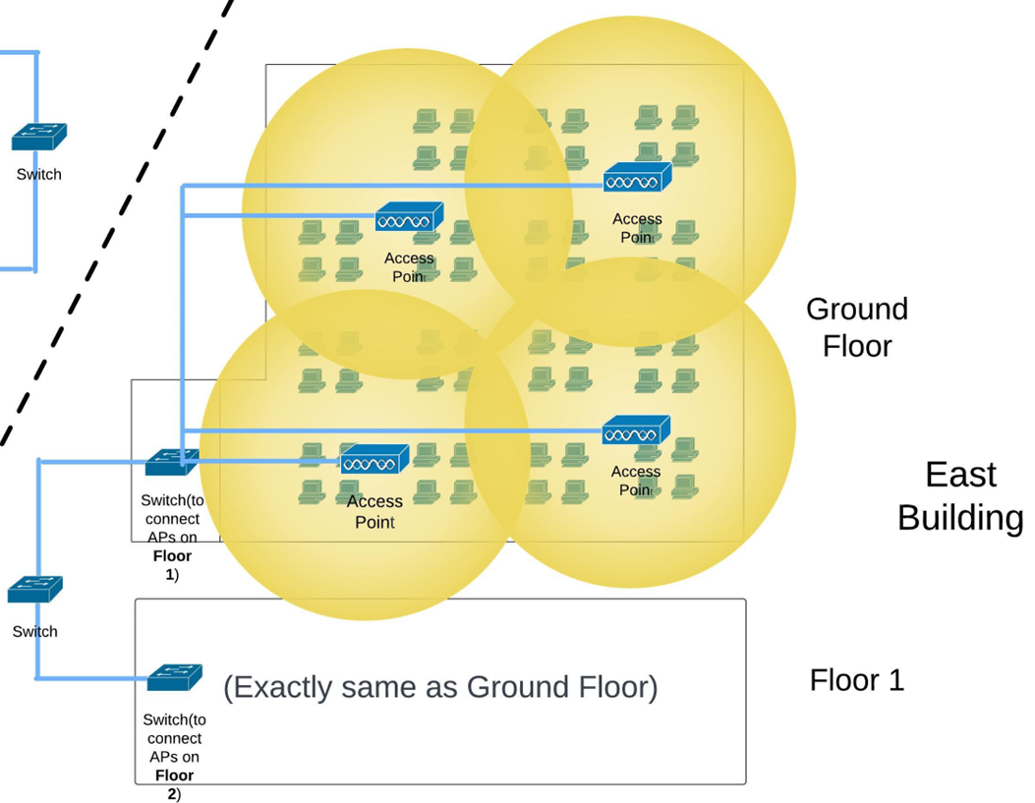
Appendix: Details of Design
As for distance between APs and switches,
Also based on scale, the measurement results are: 32m, 16m.
And there are also 3-meter-long distances between the switches on Floor 1 and the main switch on Ground Floor.
16m
32m
3m

Slide 24
Appendix: Details of Devices
TP-Link EAP223
Offers up to 450Mbps on 2.4 GHz and 867 Mbps on 5GHz, totally 1317 Mbps.
EAP223 | AC1350 Wireless MU-MIMO Gigabit Ceiling Mount Access Point | TP-Link Australia
TL-SG116
Offers 16 ports for 10/100/1000Mbps supporting Auto-MDI/MDIX
TL-SG116 | 16-Port Gigabit Desktop Switch | TP-Link Australia

Slide 25
Appendix: Details of Devices
TL-SG116P
16-port Gigabit Desktop switch with 16-port PoE+.
TL-SG116P | 16-Port Gigabit Desktop Switch with 16-Port PoE+ | TP-Link
Archer AX10000
Offers over 10Gbps with 4804 with 4804 Mbps on each of the two 5 GHz bands and 918 Mbps on the 2.4 GHz band.
Archer AX10000 | AX10000 Next-Gen Tri-Band Gaming Router | TP-Link

